Slide 1
Command and Control
Brandon Moe

Slide 2
Todays Topics
Using Command and Control

Slide 3
Quick Review

Slide 4
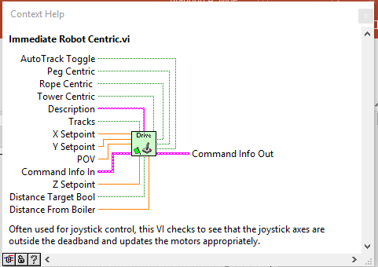
Commands
These will call a command using setpoints given to this command
Ex: Drive Immediate Robot Centric

Slide 5
How to use commands in Teleop

Slide 6

Feedback Node
This will give you the value from the last iteration of the program
Commonly used in calling commands

Slide 7
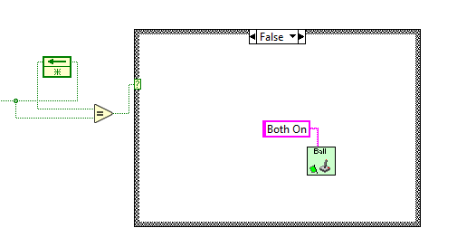
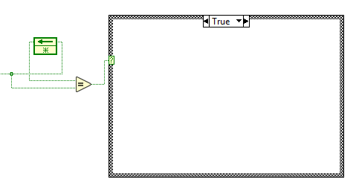
How to properly call a command

Slide 8
Why do I need to do it like this??
We are looking for the fastest run time our robot can have and this will give it to us.

Slide 9
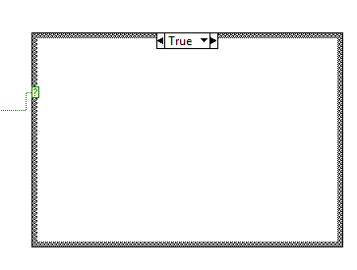
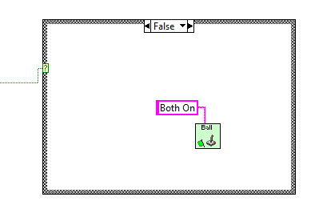
Wouldn’t this work the same??

Slide 10
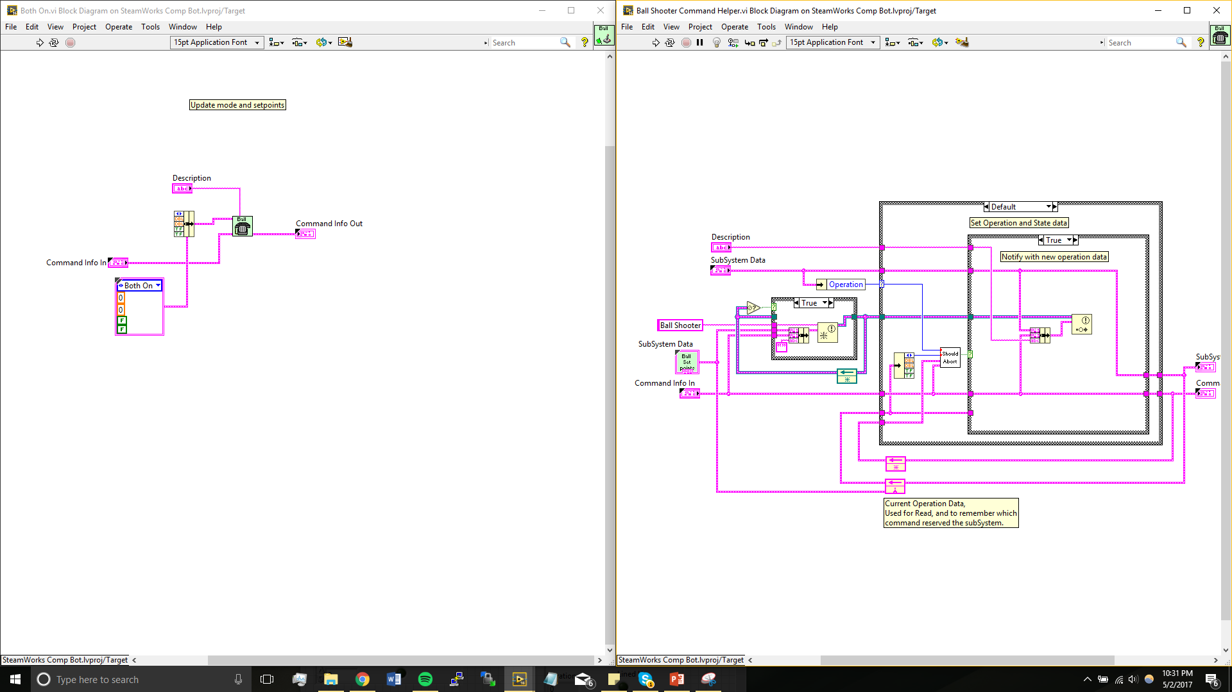
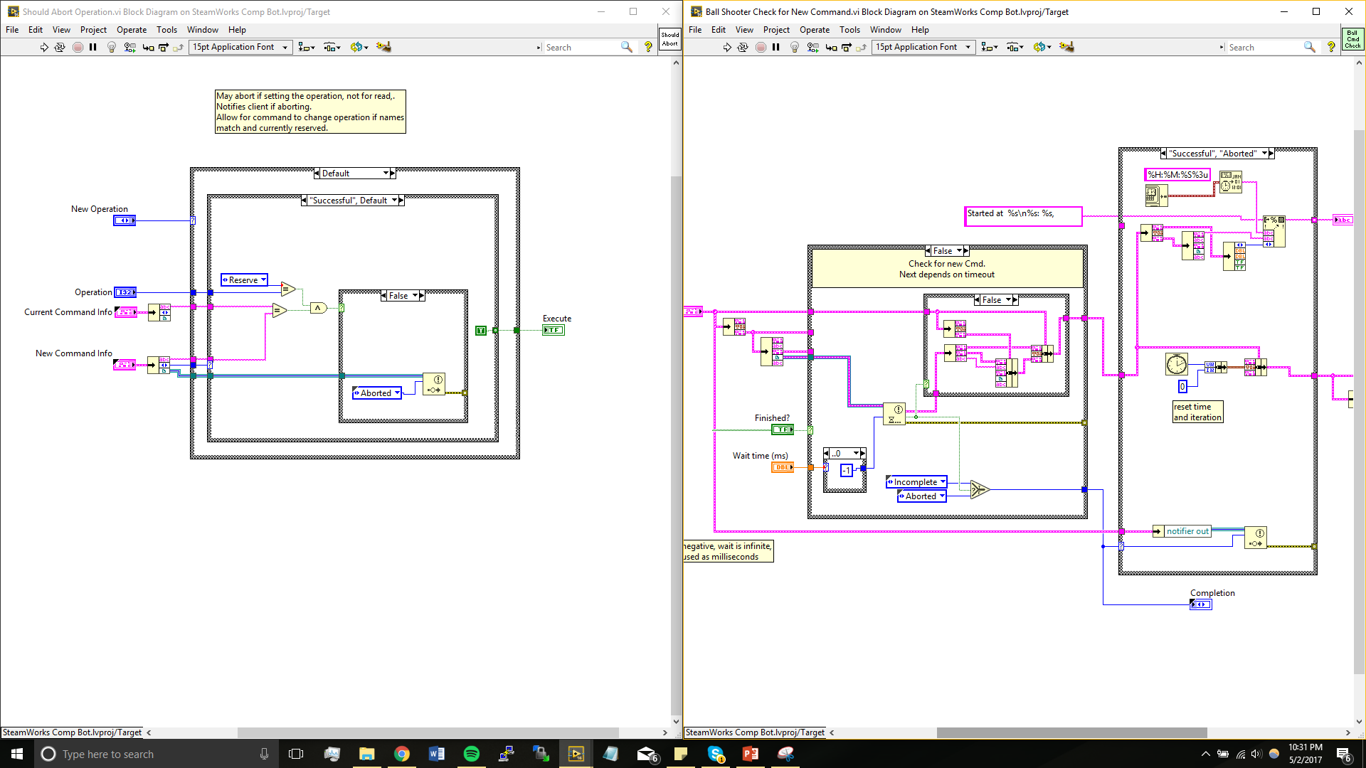
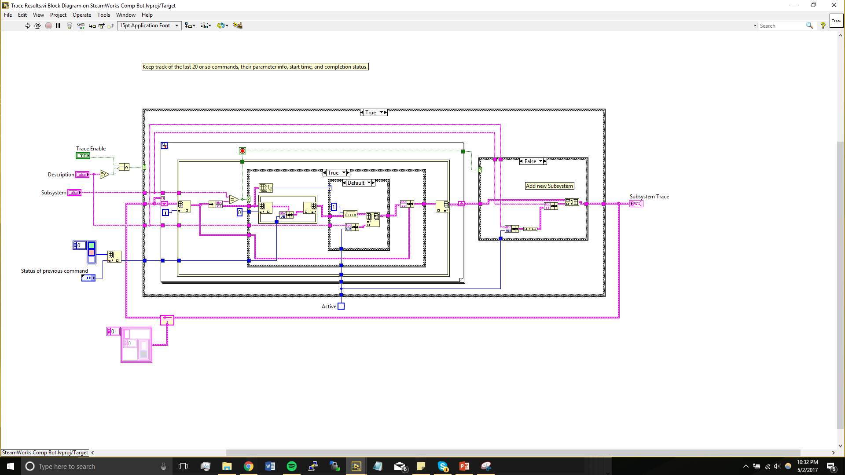
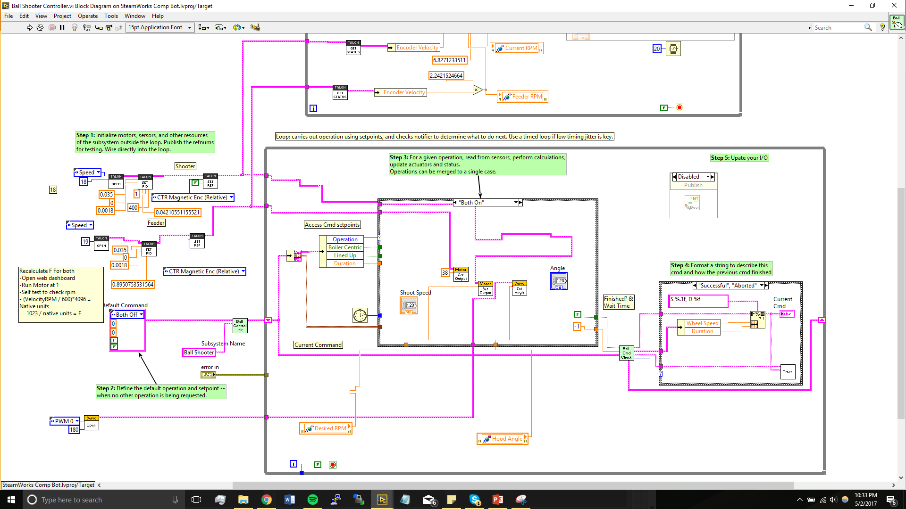
Yes, But it is slower. Look what it has to run through

Slide 11
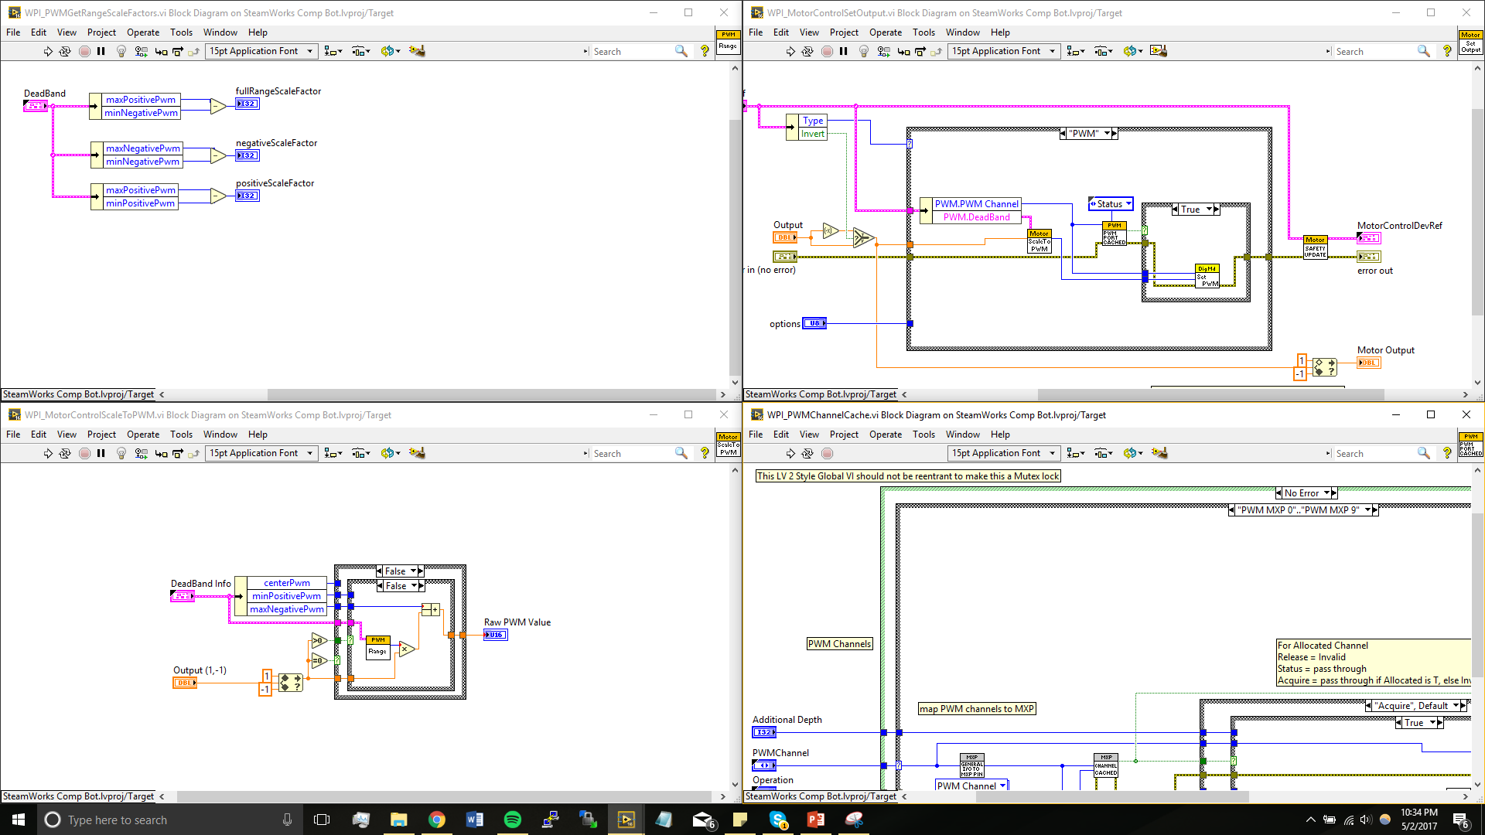
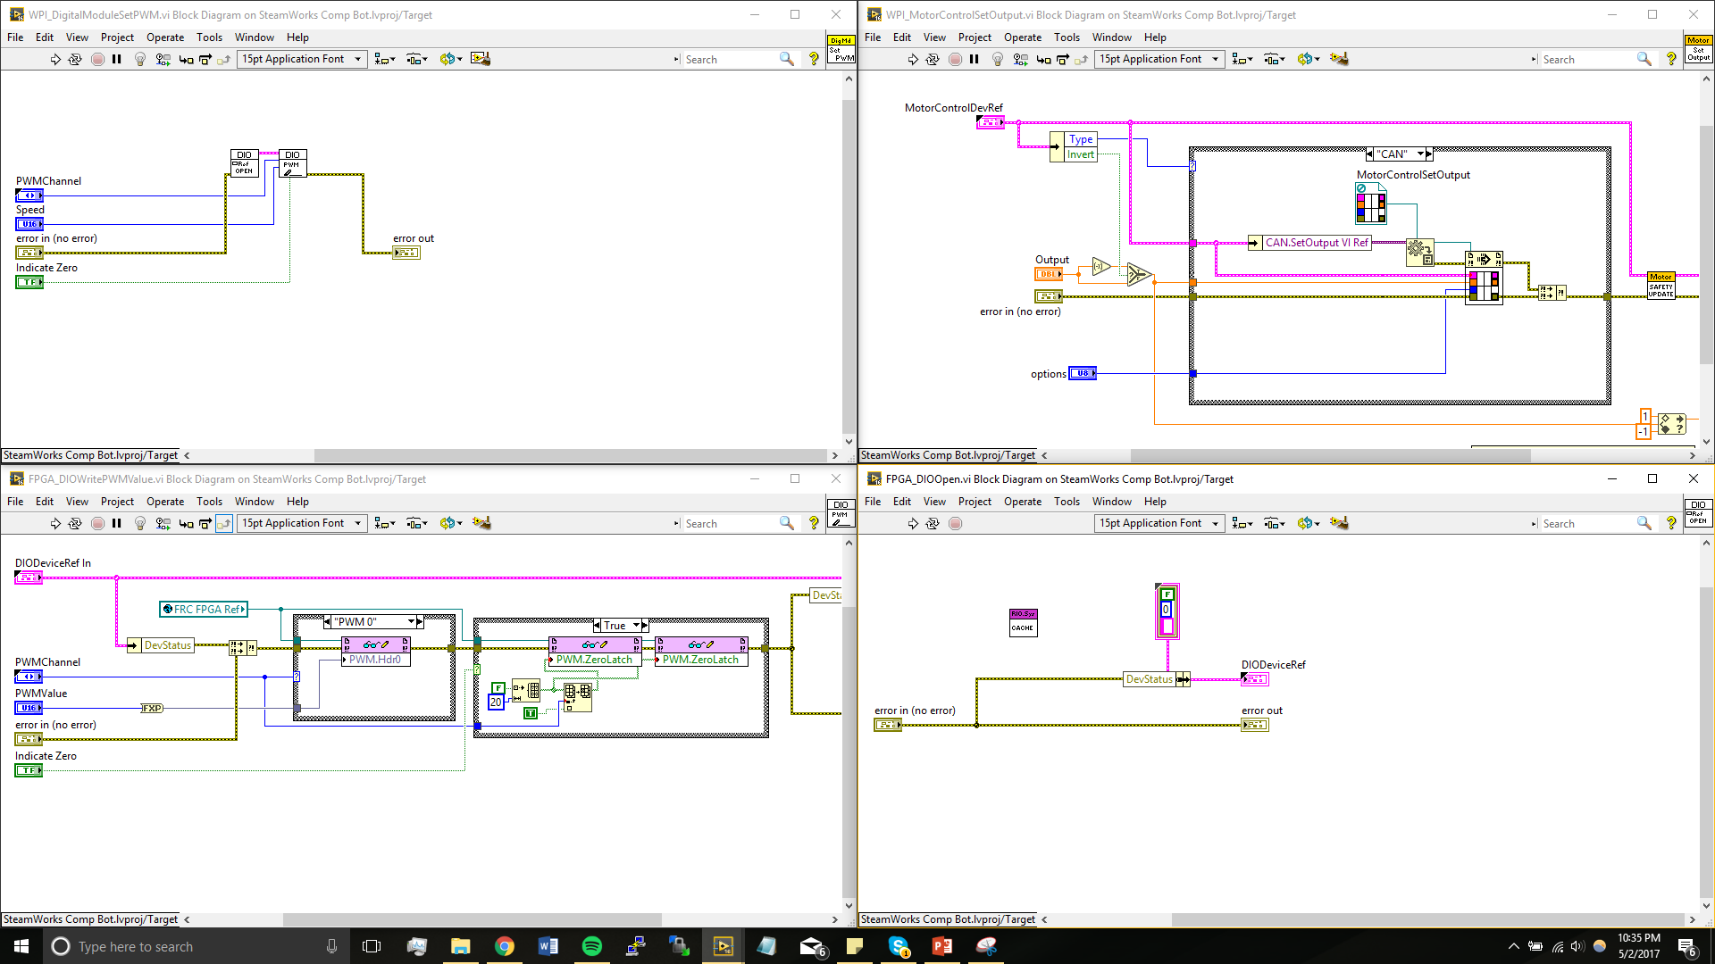
Even More…

Slide 12
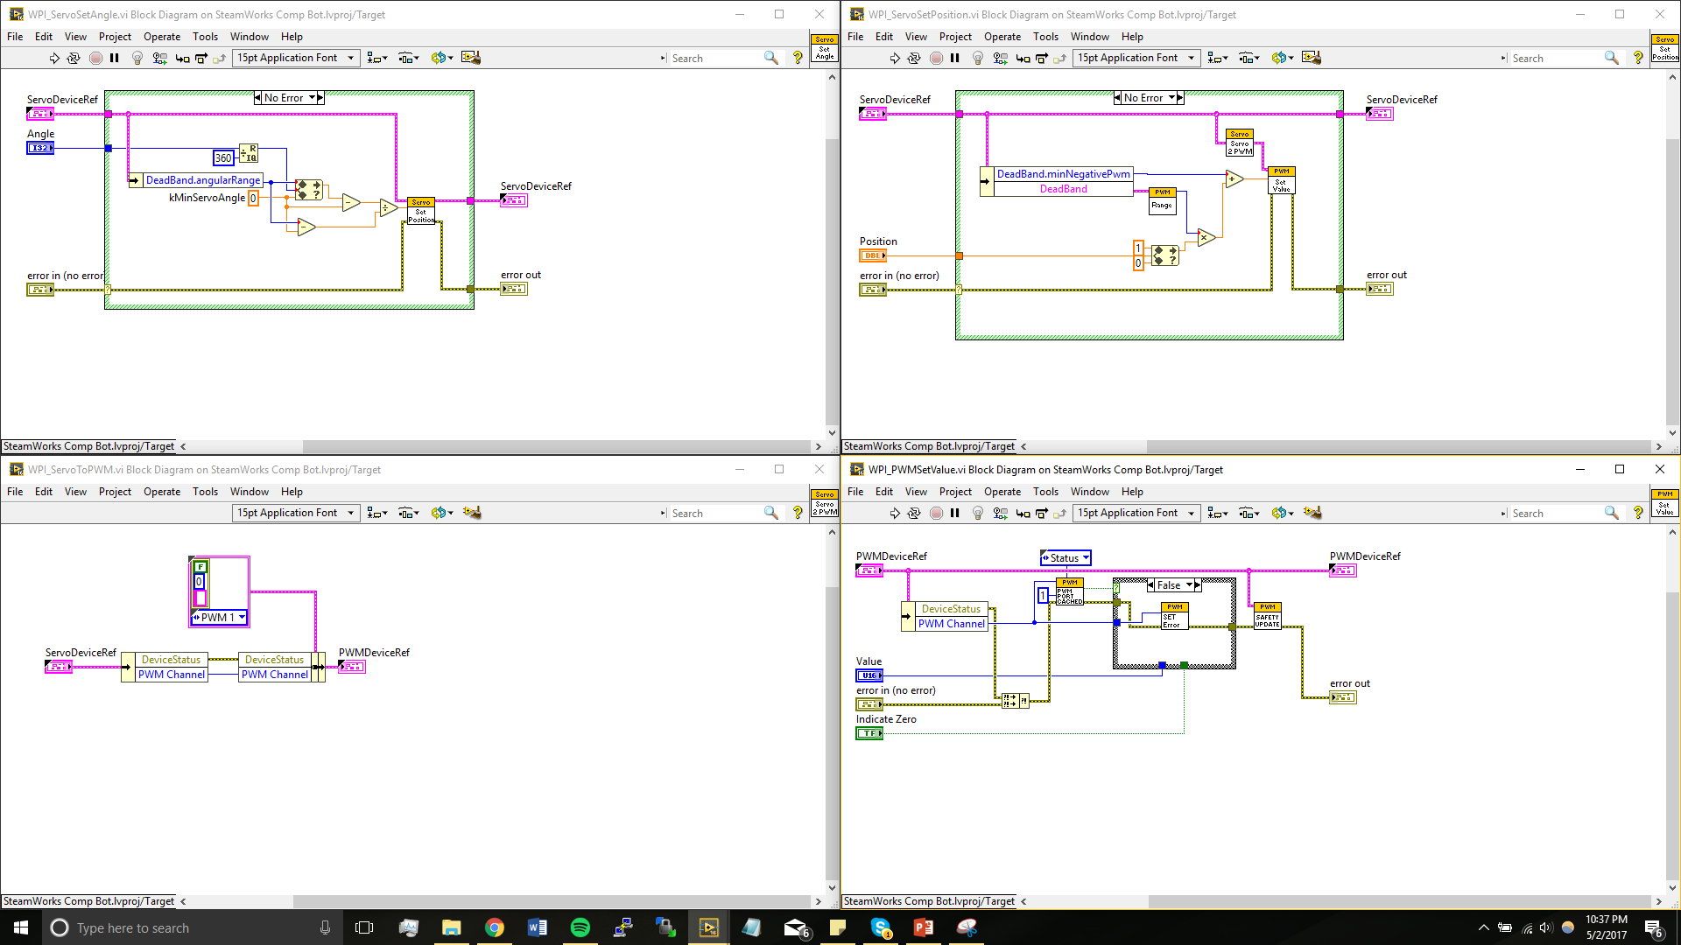
Still More
I left 75% of the code out, but the point is it has to run through a ton of code.

Slide 13
Back to doing the feedback node
This will only run the section of code once. It will remain in the state that it is in until a new command is called. (If using False -1 execution type)
Therefore it only has to run through that HUGE section of code once.

Slide 14
There is a reason behind the madness
“Your program is running to fast. You can’t ask a human to operate this robot being this quick.” – Harrison Bolzer
You can always tune a program back, but it is way harder to try to speed a program up.
Remember the RoboRio only has 2 CPU.

Slide 15
The Logic of programming Command and control

Slide 16
Your Best Friends
Case Structure
Feedback Node

Slide 17
Think it through
Never call 2 commands from the same subsystem at one time
Trust me, from experience, bad things happen
Some of the logic will get messy
Don’t be afraid to ask someone to look through your logic.

Slide 18
Side notes
Things that need updated values, like drivetrain and our shooter, CAN NOT run on a feedback node. These need to be called every time
Things like the ball or gear intake, which run on constant values, should only be called once to increase run time.

Slide 19
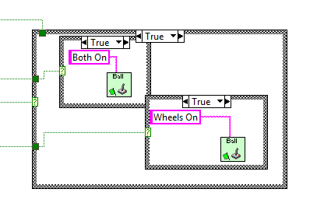
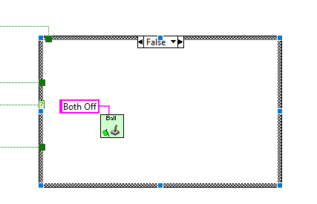
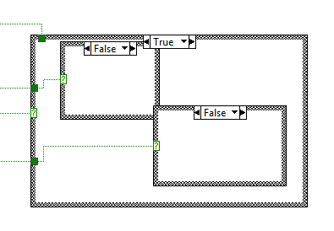
Example
Ball Shooter (no feedback node)

Slide 20
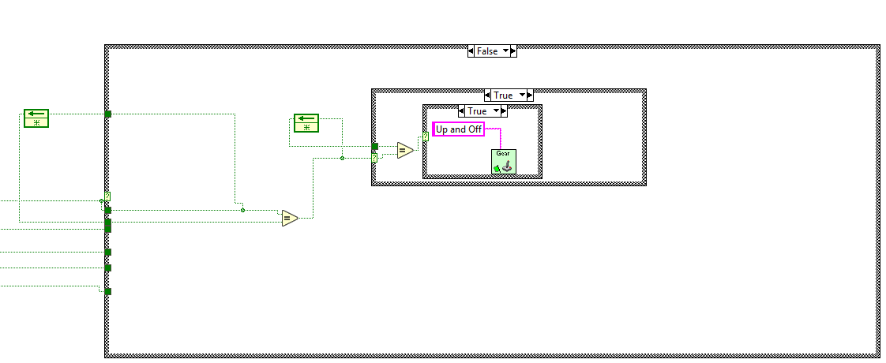
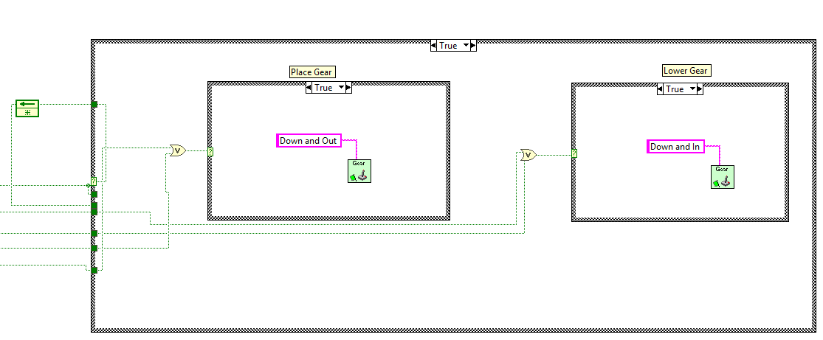
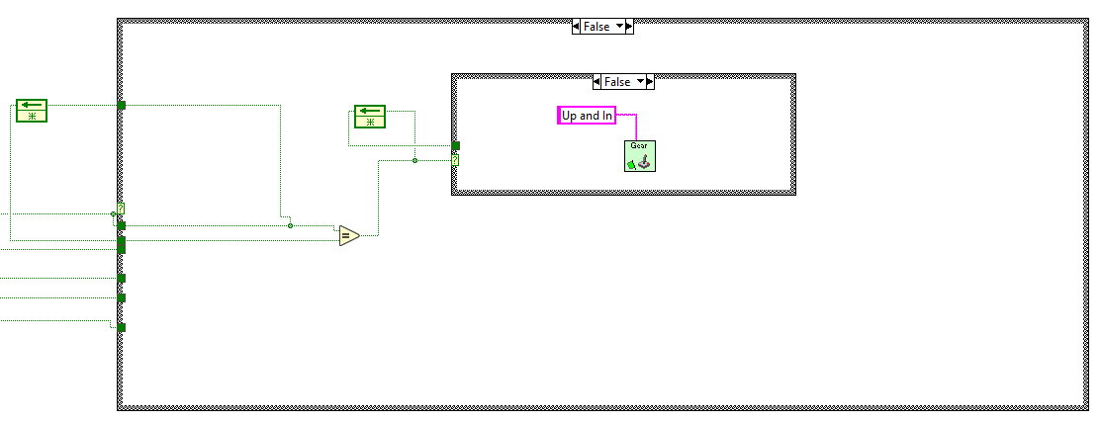
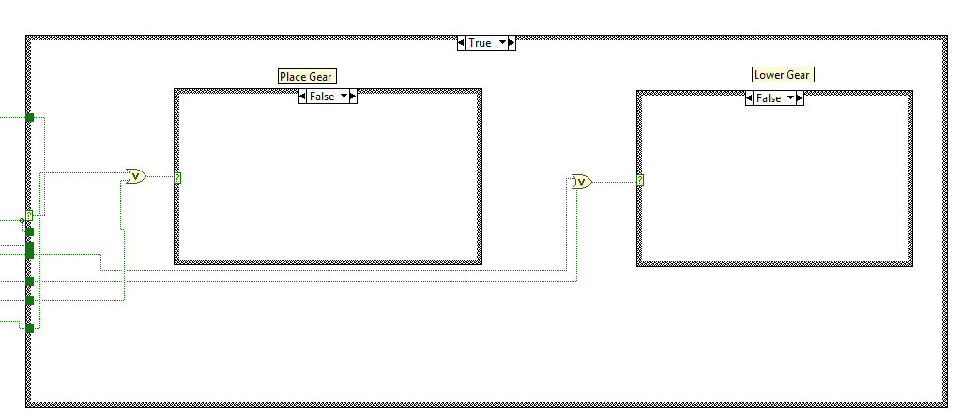
Example
Gear Manipulator (Feedback Nodes)

Slide 21
Project 4
In Teleop put the two commands, intake forward and intake reverse, from Intake subsystem. You will be doing this two ways.
1. With feedback nodes
2. Without feedback nodes
Manipulator Joystick button 5 is forward
Manipulator Joystick button 6 is reverse
Slider on manipulator joystick is wheel speed

